Slide 1
Lecture 07 – CNN Applications and Tricks
Prof. André Gustavo Hochuli
gustavo.hochuli@pucpr.br
aghochuli@ppgia.pucpr.br
Notes:
Prof. André Hochuli

Slide 2
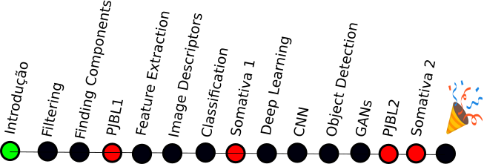
Topics
Convolutional Neural Network
Basic Concepts
Archicteture and Hiper Parameters
Data Augmentation
Transfer-Learning
Applications
Practice
Computer Vision - Prof. André Hochuli
Lecture 07
Notes:
Prof. André Hochuli

Slide 3
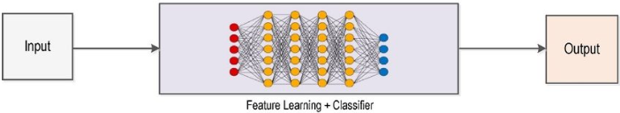
Deep Learning Pipeline
Computer Vision - Prof. André Hochuli
Lecture 10
Notes:
Prof. André Hochuli

Slide 4
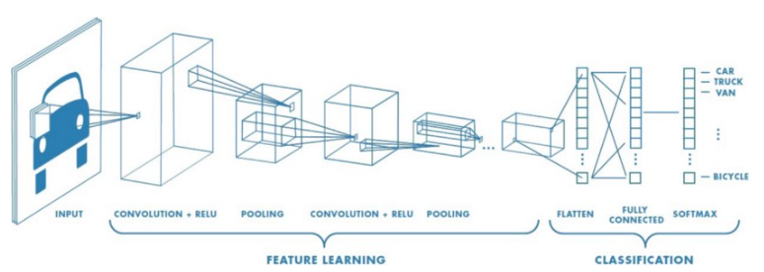
Convolutional Neural Network
CNN
Computer Vision - Prof. André Hochuli
Lecture 10
Notes:
Prof. André Hochuli

Slide 5
Convolutional Neural Network
Feature Extraction
Computer Vision - Prof. André Hochuli
Lecture 10
Notes:
Prof. André Hochuli

Slide 6
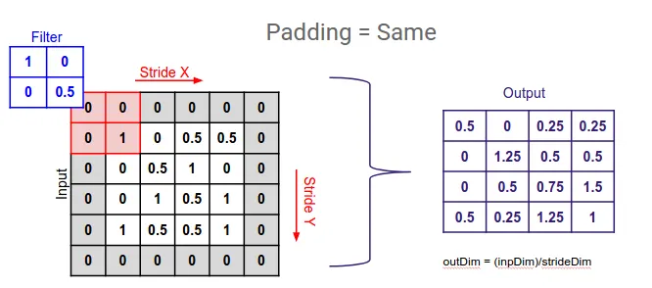
Convolutional Neural Network
Convolutional Layer (Learnable Filters)
Padding
Stride
Kernel Size
Number of Filters
Computer Vision - Prof. André Hochuli
Lecture 10
Notes:
Prof. André Hochuli

Slide 7
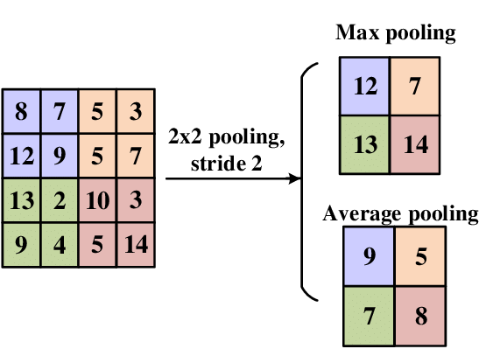
Convolutional Neural Network
Pooling Layer
Reduce Spatial Dimensions
Translation-Invariant
Common Filter
Max: Preserve the “strongest” features
Average: Smooth features, preserves general representations
Computer Vision - Prof. André Hochuli
Lecture 10
Notes:
Prof. André Hochuli

Slide 8
Convolutional Neural Network
Classification
Forward and Back Propagation
Computer Vision - Prof. André Hochuli
Lecture 10
Notes:
Prof. André Hochuli

Slide 9
Convolutional Neural Network
Forward and Back Propagation
Computer Vision - Prof. André Hochuli
Lecture 10
Notes:
Prof. André Hochuli

Slide 10
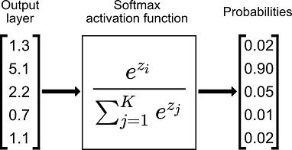
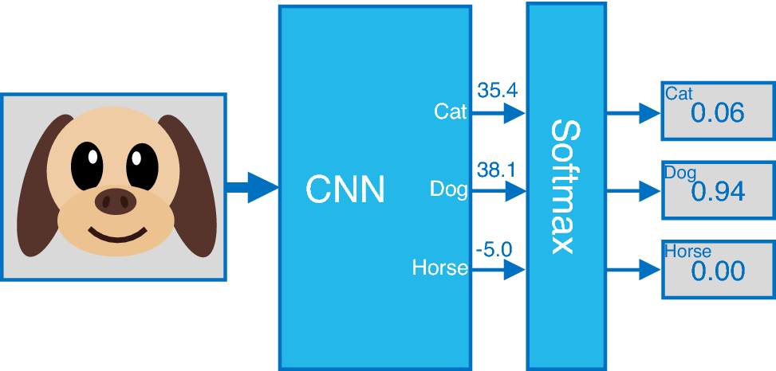
Convolutional Neural Network
Softmax
Computer Vision - Prof. André Hochuli
Lecture 10
Notes:
Prof. André Hochuli

Slide 11
Convolutional Neural Network
Lets code our first CNN from scratch
Computer Vision - Prof. André Hochuli
Lecture 10
Notes:
Prof. André Hochuli

Slide 12
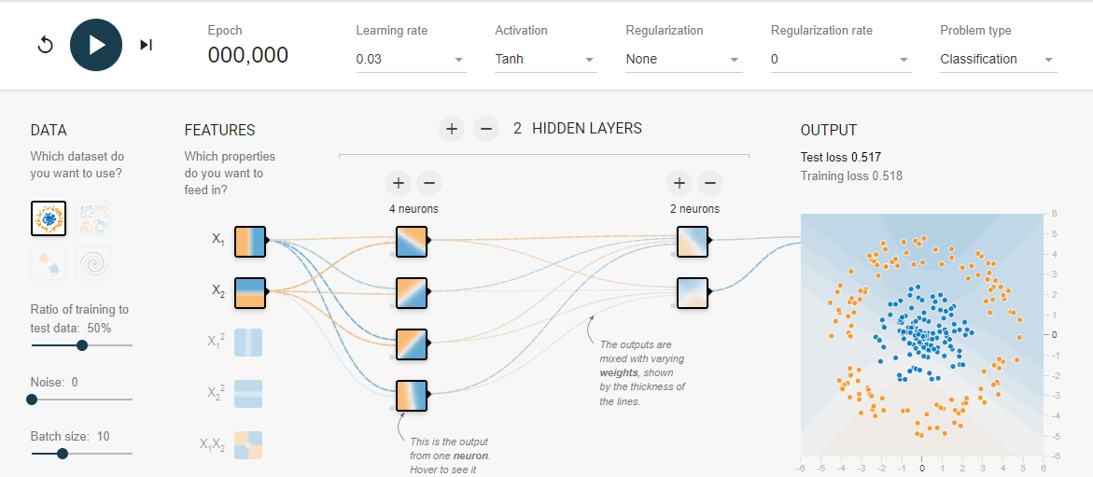
Convolutional Neural Network
Tensorflow Playground
https://playground.tensorflow.org/
Computer Vision - Prof. André Hochuli
Lecture 10
Notes:
Prof. André Hochuli

Slide 13
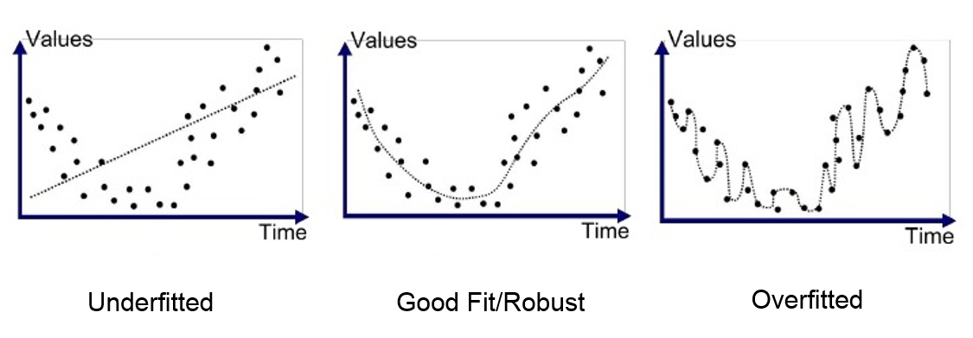
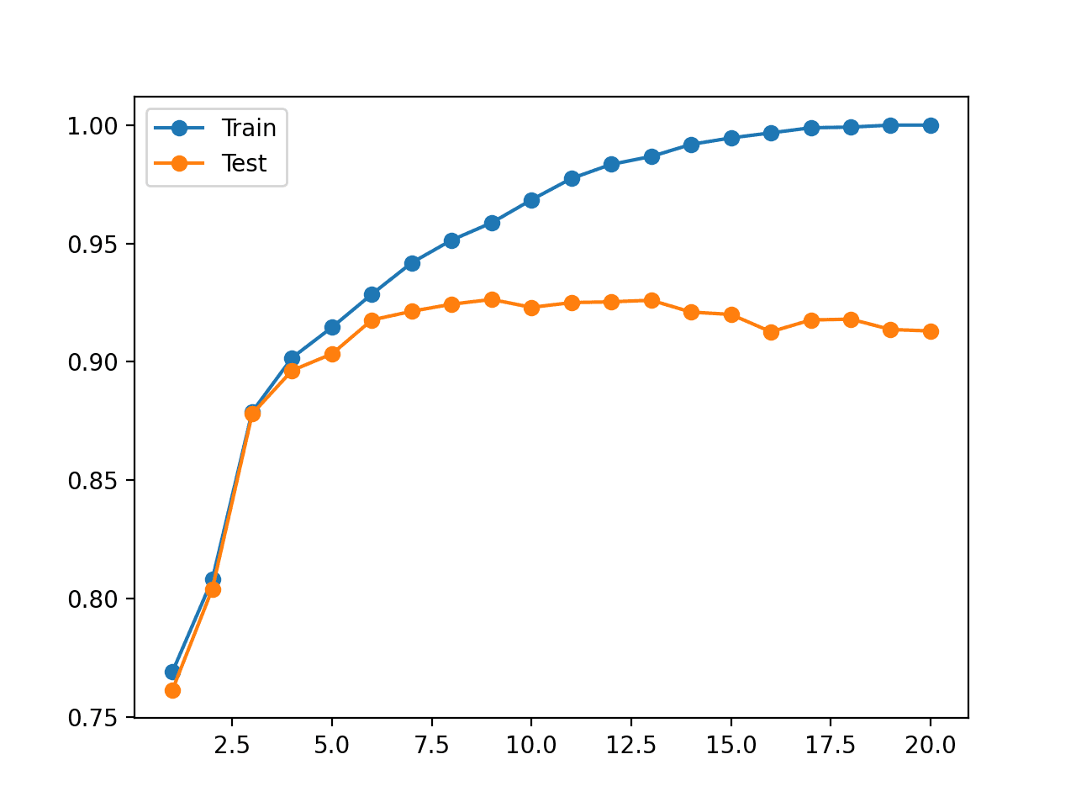
Overfitting
Bad generalization
Computer Vision - Prof. André Hochuli
Lecture 10
Notes:
Prof. André Hochuli

Slide 14
Overfitting
Bad generalization
Computer Vision - Prof. André Hochuli
Lecture 10
Notes:
Prof. André Hochuli

Slide 15
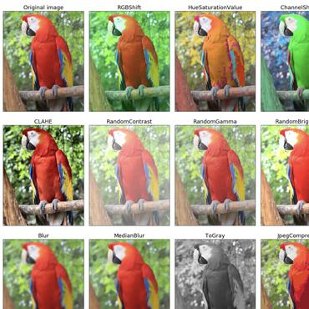
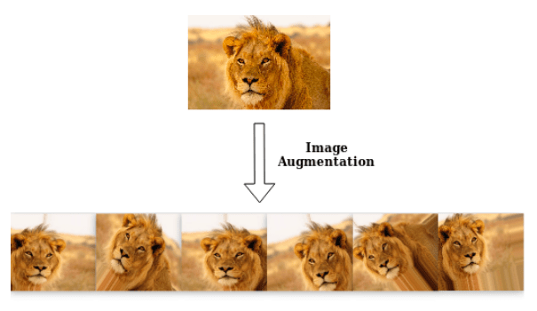
Data Augmentation
Enlarge the dataset with synthetic samples
Computer Vision - Prof. André Hochuli
Lecture 10
Notes:
Prof. André Hochuli

Slide 16
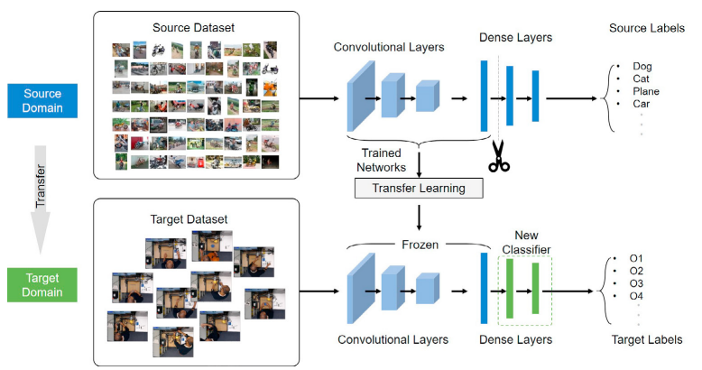
Transfer Learning
Weight Sharing
Feature Extraction weights are frozen (or not...) during learning
Computer Vision - Prof. André Hochuli
Lecture 10
Notes:
Prof. André Hochuli

Slide 17
Let’s Code
[LINK]
Computer Vision - Prof. André Hochuli
Lecture 10
Notes:
Prof. André Hochuli

